Slide 1
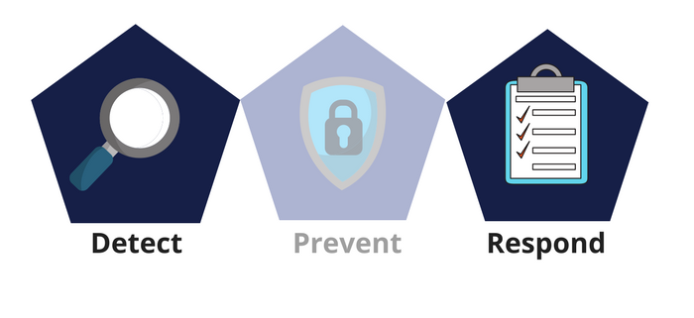



Network Security
Class IX
lab 25

Slide 2


Network Security
the practice of preventing and protecting against unauthorized intrusion into corporate networks

Slide 3

Protection Area

Slide 4

Network security basic
Protection: You should configure your systems and network as correctly as possible

Slide 5

Network security basic
Detection: You must be able to identify when the configuration has changed or when some network traffic indicates a problem

Slide 6

Network security basic
Reaction: After identifying problems quickly, you must respond to them and return to a safe state as rapidly as possible

Slide 7
Network security methods
Access control
Anti-malware
Application security
Behavioral analytics
Data loss prevention
Email security
Firewalls
Intrusion detection and prevention
Mobile device and wireless security
Network segmentation
Security information and event management (SIEM)
VPN
Web security

